Slide 1
A Guided Conversation for Herselt (BE)
University of Exeter, OCMW Laakdal, Welzijnszorg Kempen and OCMW Herselt

Slide 2
Overview
What is a Guided Conversation?
In Herselt.
Guided Conversations in Action.
Practising a Guided Conversation.
Action Plans
Organisational Considerations.

Slide 3

1. What is a Guided Conversation?
Guided Conversations (GCs): Visual prompts and topics of interest, e.g. topics about person’s day-to-day life and what should be understood in relation to their empowerment, are used to guide in-depth conversations with individuals around their experiences and opinions.

Slide 4
2. In Herselt
A collage of items that an individual may find in their living space is provided.

Slide 5
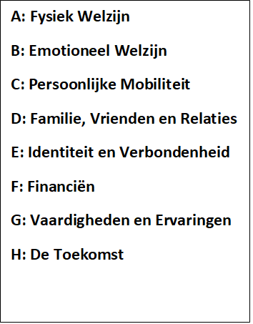
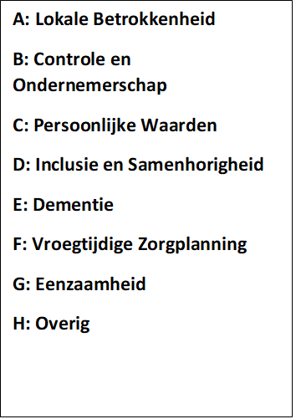
2. In Herselt
The topics are arranged into two categories - person-centred and empowerment.
Person-centred
Empowerment

Slide 6
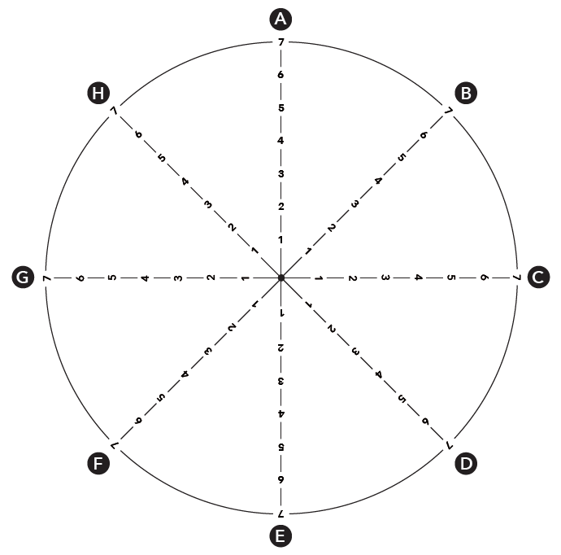
2. In Herselt
In the participant’s handbook the topics are arranged around two radars, like the one below.
The radar diagram will help participants to score topics where relevant – this is covered further on.

Slide 7
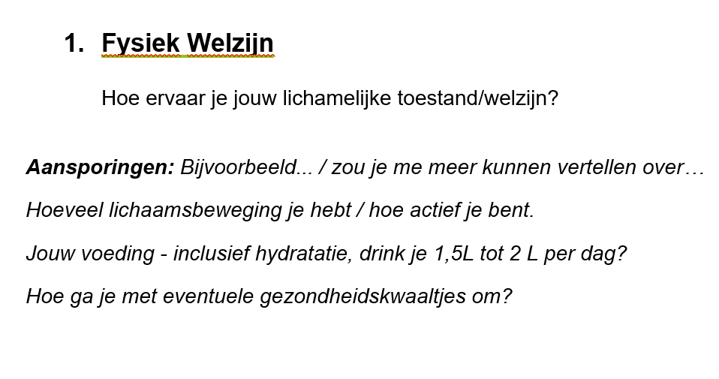
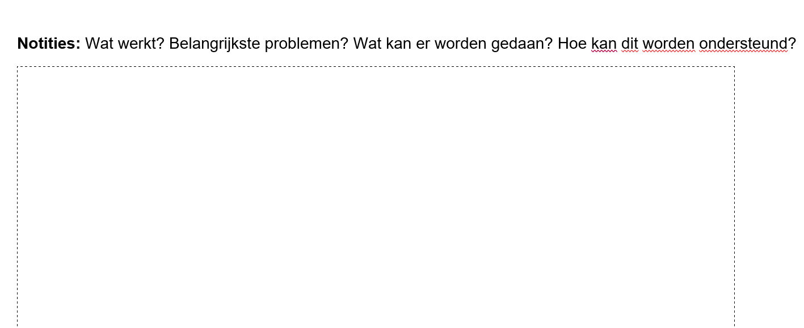

2. In Herselt
In the interviewer’s handbook, the topics are included page-by-page, with i) suggested questions, ii) space to make notes and iii) space to record topic scores.

Slide 8

3. Guided Conversations in Action
The first steps of the Guided Conversation are:
- to ensure participants are clear about the purposes of the conversation, as outlined by the project information section, and
-to ensure participants consent to how their data will be managed, as outlined by the consent information that is included.
At this stage, general demographic information can be captured too, e.g. age, gender etc.
Where possible, the administrative steps above can be spoken about in a comfortable manner.
General chat can be used to ‘break the ice’, e.g. by saying something positive that you notice about the person, their home and/or the weather!

Slide 9
3 Guided Conversations in Action
The rest of the Guided Conversation is very flexible!!!
Key Principle: Use open questions throughout, e.g. “how do you feel about…?” / “could you tell me a little bit about…?”
Key principle: Use what the participant is saying to guide the conversation, i.e. topics are not followed in order and/or prescriptively.
Key principle: Topics do not have to be asked about in detail if something relevant to that topic is mentioned while the participant is talking about another topic.

Slide 10
3. Guided Conversations in Action
Conversations can begin by showing a participant the visual that is included in their handbook and saying something like…
“How do you find living in your home? – you might like to use this image to help with your response, but you don’t have to.”

Slide 11


3. Guided Conversations in Action
Active listening is then used to guide the conversation. To actively listen…
1. Pay Attention
2. Withhold Judgement

Slide 12
3. Guided Conversations in Action - Example of how a conversation can start
Interviewer: “How do you find living in your home? – you might like to use this image to help with your response, but you don’t have to.”
Participant: “I like living here, I have been here for a long time now, but the neighbours are changing a lot and I don’t really speak to many of the people on my street”.

Slide 13
3. Guided Conversations in Action - Where to go next?
The example on the previous slide sets up the opportunity to ask about two other topics in the GC.
It does not matter which one you ask first, as long as you listen and help the conversation flow based on what the participant says and what they find important.
Examples of ‘where to go next’ are provided on the next slide.

Slide 14
3. Guided Conversations in Action - Where to go next?
Example 2. Identiteit en verbondenheid
“You mentioned that you have been living here for a long time and you like it, could you tell me about what it means to you to live here?”
Example 1. Familie, vrienden & relaties
“You mentioned your neighbours, how are your relationships with, your family and other friends?”

Slide 15
3. Guided Conversations in Action - Key Points to Cover
[Cover prompt questions that should be asked, where possible, to all participants, e.g. about nutrition and hydration under physical wellbeing. It’s good to not have too many of these ‘compulsory’ prompt questions].

Slide 16
3. Guided Conversations in Action - Topic scoring (optional)
There will be moments in the conversation where an individual naturally reaches the end of what they are saying.
These are the moments when participants can be invited to score topics.
This is not essential – just useful!
Example about... Familie, vrienden & relaties
“OK, so, if you had to score how you feel about your relationships with your family and friends out of 7, what would you give it? – don’t worry about it if you don’t want to give a score.”

Slide 17

4. Practising a Guided Conversation 1
Being familiar with the topics in a Guided Conversation before talking to a participant can help in naturally guiding the conversation.
Using the Guided Conversation materials, spend 30 minutes having a conversation in pairs. Make sure that you get a chance to play the role of the participant and the interviewer.

Slide 18

Feedback (10 mins)
How was that?

Slide 19

BREAK

Slide 20
4. Practising a Guided Conversation - Taking Notes
The notes taken during a Guided Conversation will aim to capture key points in relation to the topics around ‘what is working?’, ‘main issues’, ‘what can be done (by the individual)?’ and ‘how someone can be supported?’
If any of these aspects seem unclear, participants can be asked directly, e.g. “so, what do you think can be done?”… again, if it’s unclear from their answer, their response can be followed up, e.g. “how can you be supported with that?”
An example is provided on the next slide.

Slide 21
Transport and Moving Around: She feels well-supported by her family and usually can get a lift to places with her daughter. But, her daughter has recently got a new job. She no longer can get lifts from her daughter in the week and has never used public transport - not aware of what is available locally. She would be happy to take busses. Information on public transport would be a helpful start.
Radar Score: 2/7
Tips:
Take it slowly and listen first.
Note down a couple of sentences on the key points as follows:
What’s working?
What is the issue?
What can be done?
What support can be provided?

Slide 22
4. Practising a Guided Conversation - Taking Notes
Structured notes do not have to be taken for every topic.
If key points are mentioned and noted in reference to another topic, that can be referred to and a participant may be asked something like the example that’s shown in the next two slides.

Slide 23
Participant (about family, friends and relationships): My son visits by car at the weekends and we do food shops together. In the week, I find it difficult to go to the shops, as the bus stop is too far from my home.

Slide 24
The example on the previous slide can be used to ask about personal mobility – if there is nothing else to add, the conversation can move on.
Interviewer (about personal mobility): Earlier, you mentioned that it can be difficult to go to the shops in the week, is there anything else that you would like to say about moving around to meet your daily needs?

Slide 25

4. Practising a Guided Conversation 2
In pairs, repeat what was done during the first practising task. This time have a go at taking notes (30 mins).

Slide 26
Feedback (10 mins)
How was that?

Slide 27



5. Action Plans
The Guided Conversation materials contain an action planning section.
At the end of a conversation, problematic topics can be revisited and actions to help, based on what the participant said, can be listed.

Slide 28
5. Action Plans
Low-scoring topics can help in identifying what should be concentrated on in an action plan.
Actions towards issues should be practical and include the individual. Local resources can be signposted, and/or support can be given to an individual to access resources. Where problems are more profound, responsible individuals can be alerted through a referral.
Therefore, three-tiers of actions can be considered:
i. Wegwijzers
ii. Ondersteuning
iii. Doorverwijzing

Slide 29
6. Organisational Considerations
Teams using GCs can meet at regular intervals to discuss learning (GC notes can be passed on to team leaders beforehand) – particularly in relation to any issues that need a referral.
Responsible individuals can then be alerted to make contact with relevant participants.

Slide 30
6. Organisational Considerations
Meetings should also be organised so that volunteers feel part of a team and discuss issues that they have endured (such conversations can be emotional).
Team leaders can feature in these meetings, but providing opportunities and time for volunteers to talk to each other in a comfortable environment is important.

